Slide 1
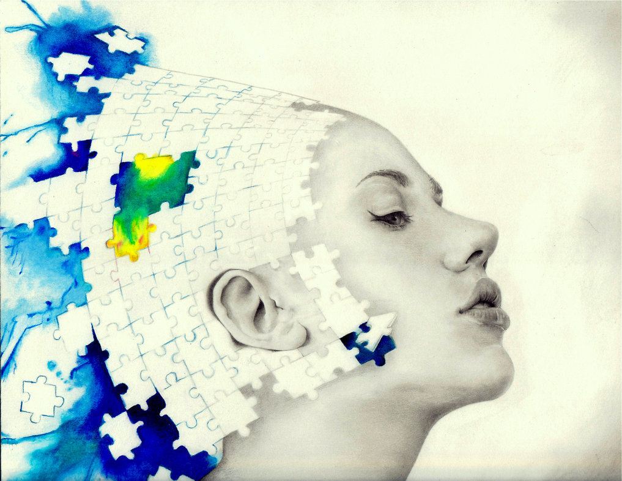
THE ORIGINS OF EXCEPTIONAL PERFORMANCE IN THE ARTS: BEYOND BORN VS. MADE
Zach Hambrick, Michigan State University
16 May, 2016
Brain and Culture Symposium, Karolinska Institutet

Slide 2
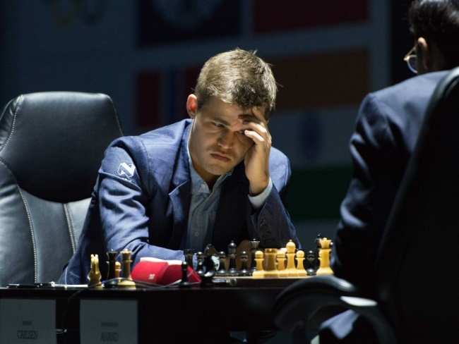
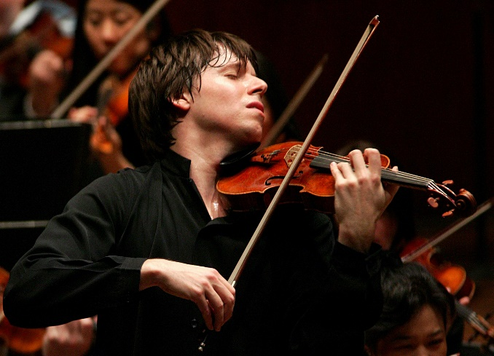
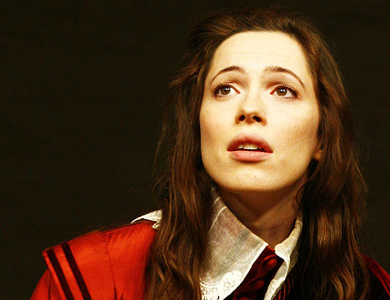
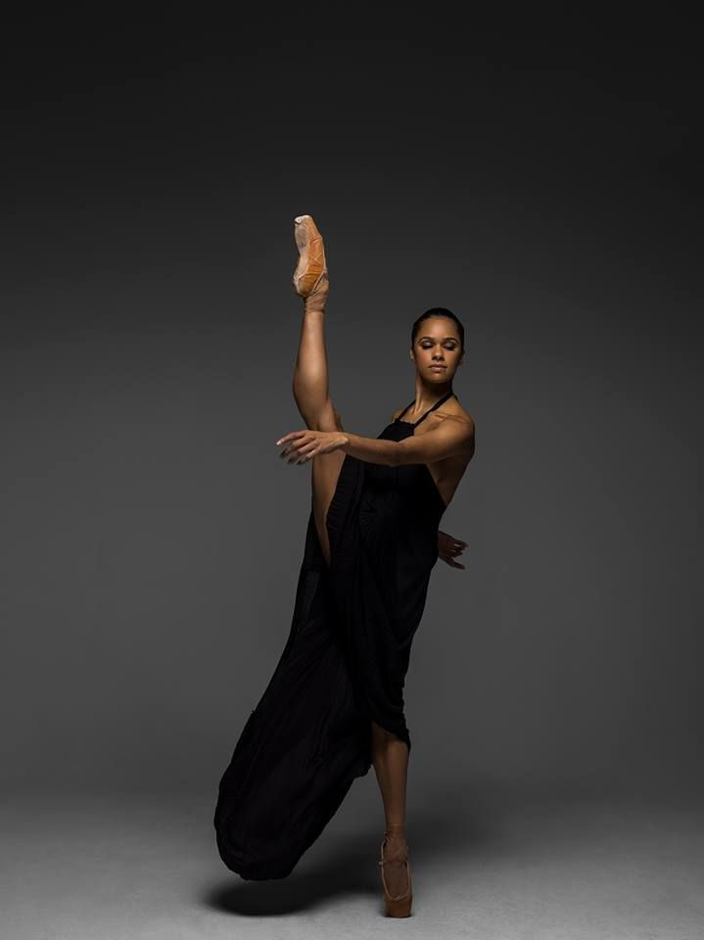
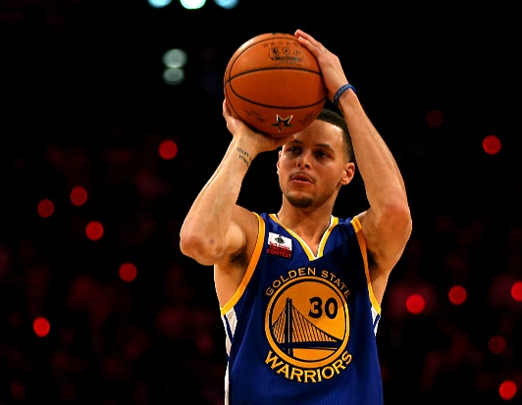

VARIABILITY IN SKILL

Slide 3

VARIABILITY IN SKILL
- Learned moves of chess at 5
- Took up game seriously at 8
- Grandmaster at 13
- FIDE World No. 1 at 19
- Highest rating in history at 24

Slide 4
VARIABILITY IN SKILL
- Learned moves of chess at 5
- Took up game seriously at 8
- Grandmaster at 13
- FIDE World No. 1 at 19
- Highest rating in history at 24
April 2016: World No. 1 in classical, rapid, and blitz chess

Slide 5
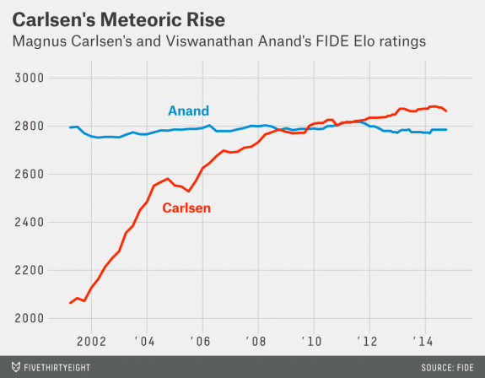
VARIABILITY IN SKILL

Slide 6
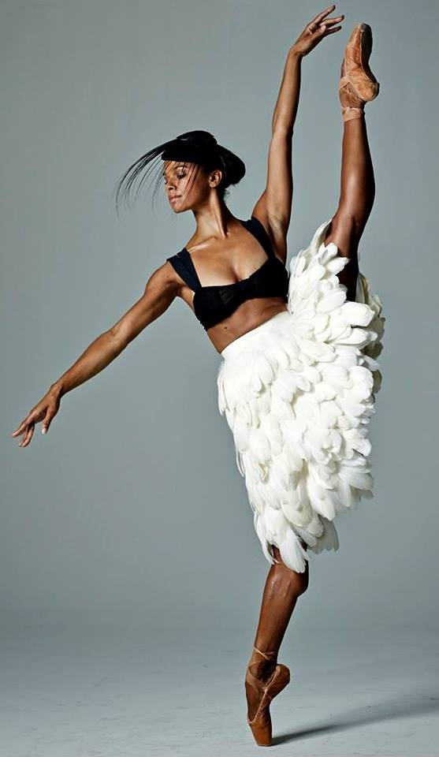
VARIABILITY IN SKILL
- Started ballet at 13
- Won Los Angeles Spotlight award at 15
- Member of American Ballet Theatre at 18
- American Ballet Theatre soloist at 25
- Presently principal dancer for ABT

Slide 7

THE SCIENCE OF EXPERTISE
?
What factors explain this striking variability?

Slide 8
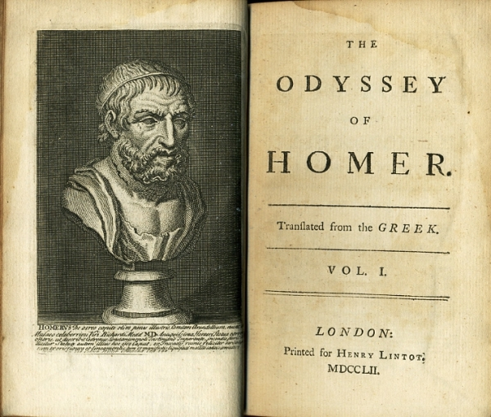
BORN VS. MADE
So it is that gods do not give all men the gifts of grace—neither good looks nor intelligence nor eloquence.”
“

Slide 9
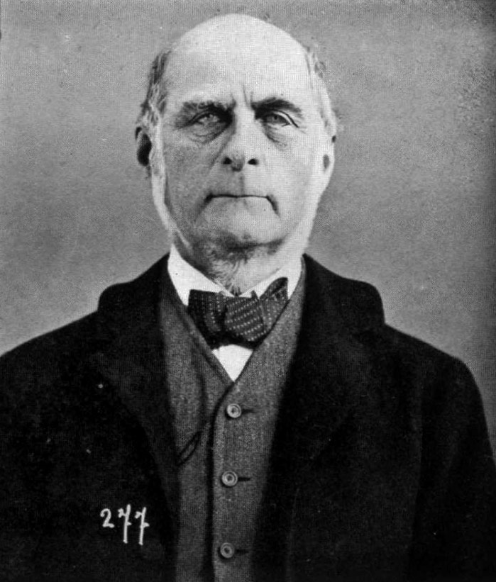
BORN VS. MADE
I HAVE no patience with the hypothesis occasionally expressed, and often implied, especially in tales written to teach children to be good, that babies are born pretty much alike, and that the sole agencies in creating differences between boy and boy, and man and man, are steady application and moral effort.”
- Francis Galton (1869)
“

Slide 10
BORN VS. MADE
“
[S]ocial hindrances cannot impede men of high ability, from becoming eminent [and] social advantages are incompetent to give that status, to a man of moderate ability.”
- Francis Galton (1869)

Slide 11
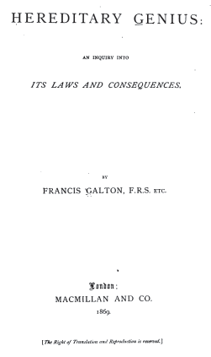
BORN VS. MADE

Slide 12
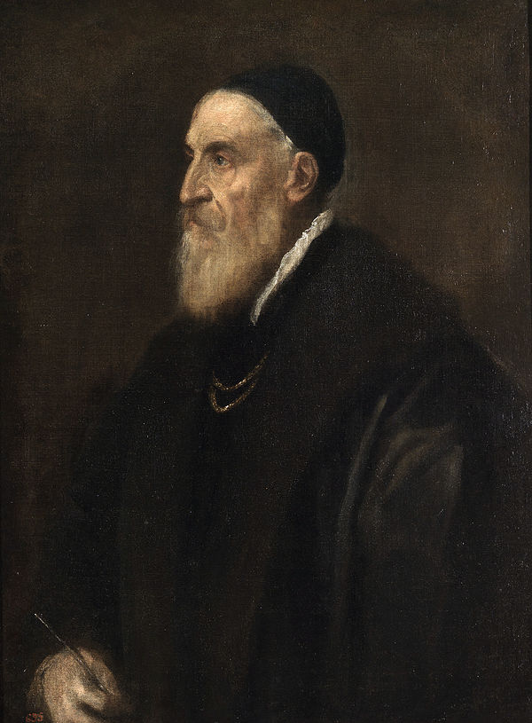
BORN VS. MADE

Slide 13
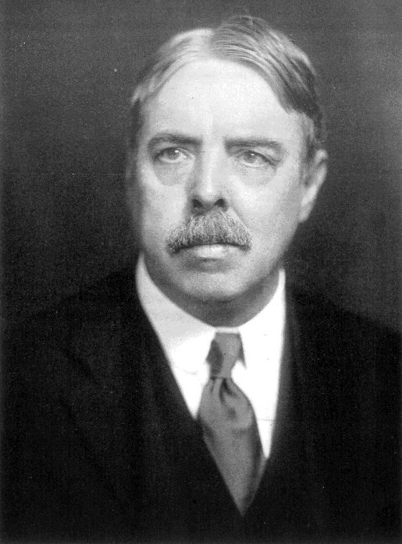
BORN VS. MADE
[W]hen one sets oneself zealously to improve any ability, the amount gained is astonishing…we stay far below our own possibilities in almost everything we do…not because proper practice would not improve us further, but because we do not take the training or because we take it with too little zeal.”
- Edward Thorndike (1911)
“

Slide 14
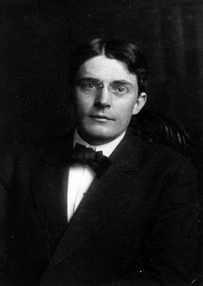
BORN VS. MADE
Give me a dozen healthy infants, well-formed, and my own specified world to bring them up in and I'll guarantee to take any one at random and train him to become any type of specialist I might select - doctor, lawyer, artist, merchant-chief and, yes, even beggar-man and thief, regardless of his talents, penchants, tendencies, abilities, vocations…”
- John Watson (1930)
“

Slide 15
BORN VS. MADE
[P]racticing more intensively than others…is probably the most reasonable explanation we have today not only for success in any line, but even for genius.”
- John Watson (1930)
“

Slide 16

BORN VS. MADE
individual differences in ultimate performance can largely be accounted for by differential amounts of past and current levels of practice.”
- Ericsson et al. (1993)
“
K. Anders Ericsson, Florida State U.

Slide 17
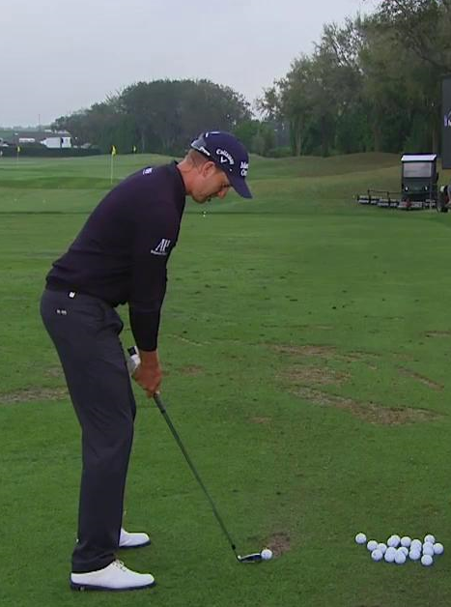
BORN VS. MADE
Ericsson et al. (1993) proposed the term deliberate practice to refer to those training activities that were designed solely for the purpose of improving individuals' performance by a teacher or the performers themselves.”
- Ericsson (1998)
“
“
[Deliberate practice] activities can be designed by external agents, such as teachers or trainers, or by the performers themselves.”
- Keith & Ericsson (2007)

Slide 18
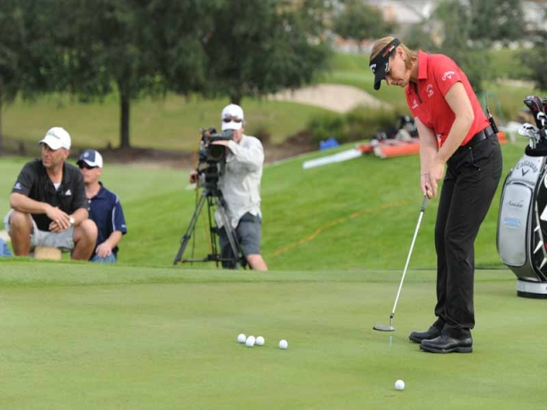
BORN VS. MADE
Ericsson et al. (1993) proposed the term deliberate practice to refer to those training activities that were designed solely for the purpose of improving individuals' performance by a teacher or the performers themselves.”
- Ericsson (1998)
“
“
[Deliberate practice] activities can be designed by external agents, such as teachers or trainers, or by the performers themselves.”
- Keith & Ericsson (2007)

Slide 19
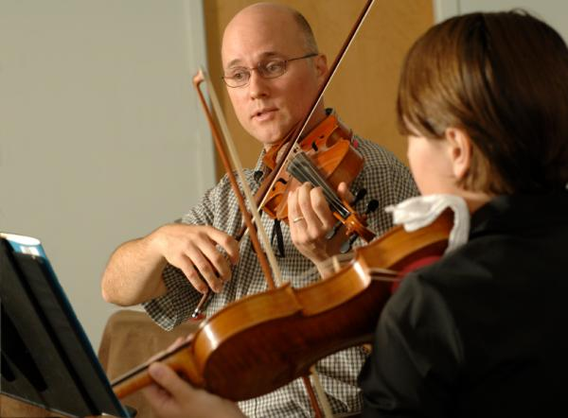
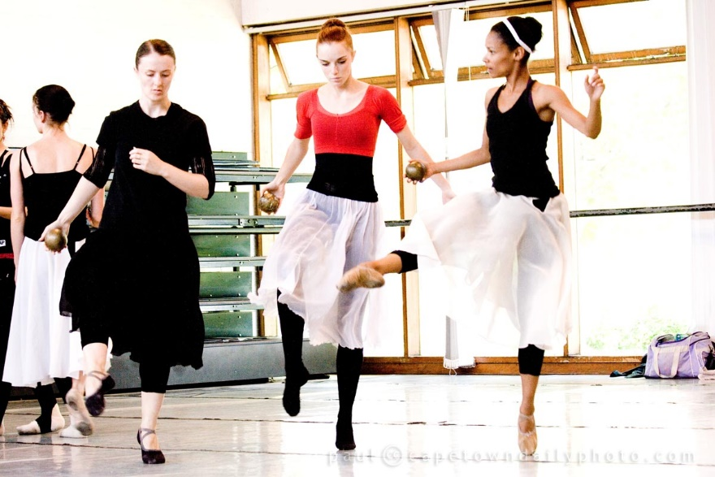
BORN VS. MADE

Slide 20
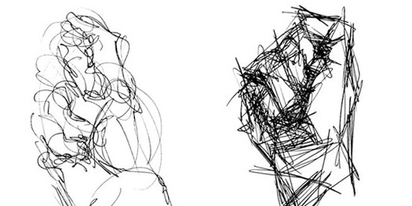
BORN VS. MADE
What is deliberate practice in art?

Slide 21
BORN VS. MADE
This article argues that it is possible to account for the development of elite performance among healthy children without recourse to unique talent (genetic endowment) — excepting the innate determinants of body size. This account based on the expert-performance approach shows that the distinctive characteristics of elite performers are adaptations to extended and intense practice activities that selectively activate dormant genes that all healthy children's DNA contain.”
- Ericsson (2007), International Journal of Sport Psychology
“

Slide 22



BORN VS. MADE
We actually find that with the right kind of training any individual will be able to acquire abilities that were previously viewed as only attainable if you had the right kind of genetic talent.”
- K. Anders Ericsson
Freakonomics Radio, April 27, 2016
“

Slide 23
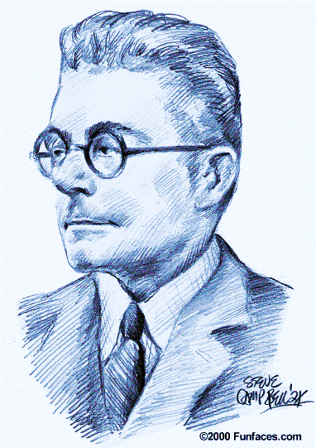
BORN VS. MADE
We actually find that with the right kind of training any individual will be able to acquire abilities that were previously viewed as only attainable if you had the right kind of genetic talent.”
- K. Anders Ericsson
Freakonomics Radio, April 27, 2016
“

Slide 24

BORN VS. MADE
We actually find that with the right kind of training any individual will be able to acquire abilities that were previously viewed as only attainable if you had the right kind of genetic talent.”
- K. Anders Ericsson
Freakonomics Radio, April 27, 2016
“

Slide 25

BORN VS. MADE
“
[U]ntil Ericsson shows cognitive expertise development in a randomly selected group of subjects, including those with
moderate mental retardation, there is no reason to believe that such development can be accomplished. In the absence of such data, over 100 years of intelligence and educational research results suggest that Ericsson's claims should be taken with great reluctance, because they may have highly disappointing results for parents and others who have great hopes, but no data on which to base such hopes.”
- Ackerman (2014), Intelligence
Philip Ackerman, Georgia Tech

Slide 26
HOW IMPORTANT IS TRAINING?
Research Question: Does deliberate practice account for all, nearly all, or at least most of the variance in skill?

Slide 27
HOW IMPORTANT IS TRAINING?
Major inclusion criterion: Measures of one or more activities interpretable as deliberate practice and of performance were collected.

Slide 28
HOW IMPORTANT IS TRAINING?
Chess
6 studies
Hambrick et al. (2014), Intelligence

Slide 29
HOW IMPORTANT IS TRAINING?
Music
8 studies
Hambrick et al. (2014), Intelligence

Slide 30
HOW IMPORTANT IS TRAINING?
Sports
33 studies
N = 2765
Overall
Objective Performance
Deliberate Practice
Individual Deliberate Practice
Other
Macnamara, Moreau, & Hambrick (2016), Perspectives on Psychological Science

Slide 31
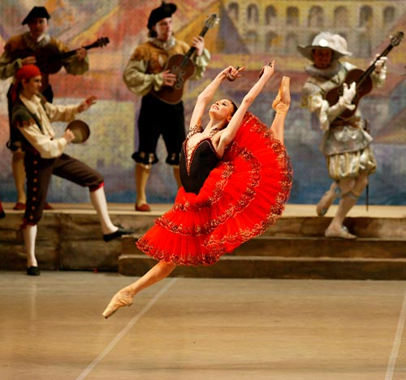
HOW IMPORTANT IS TRAINING?
Hutchinson, Sachs-Ericsson, and Ericsson (2014) -
Bolshoi Ballet
National Ballet of Mexico
Boston Ballet
Dance Theater of Harlem
Cleveland Ballet
Range of expertise: Principal in international company, to no professional position
N = 49
Svetlana Zakharova in Kitri Variation with the Bolshoi Ballet

Slide 32
HOW IMPORTANT IS TRAINING?
Ballet
Age 18: practice aimed at improving technique and attained level of expertise.
r = .50
Hutchinson, Sachs-Ericsson, & Ericsson (2014), High Ability Studies

Slide 33
HOW IMPORTANT IS TRAINING?
Chamberlain et al. (2015) -
- Painting/drawing experience
- Drawing techniques
- Actual drawing ability
- Self-rated drawing ability
- Personality, intelligence
N = 302

Slide 34
HOW IMPORTANT IS TRAINING?
S-R Drawing ability
7%
.30
Actual drawing ability
.25
.22
Drawing techniques
.20
.28
Drawing time
Chamberlain et al. (2015), Psychology of Aesthetics, Creativity, and Arts

Slide 35
HOW IMPORTANT IS TRAINING?
Conclusion: Deliberate practice is important, but not as important as Ericsson and colleagues have argued.

Slide 37
One piece
of a complex
puzzle

Slide 38
CAVEATS
Ericsson (2006), Figure 38.4
(1) Case for deliberate practice is based largely on cross-sectional evidence.

Slide 39
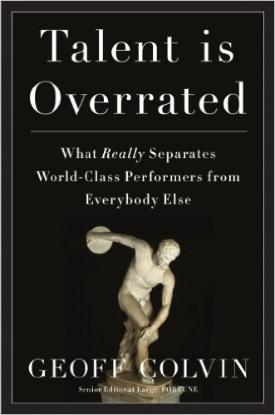
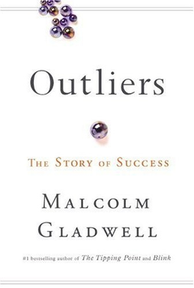
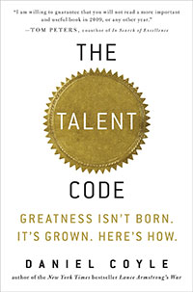
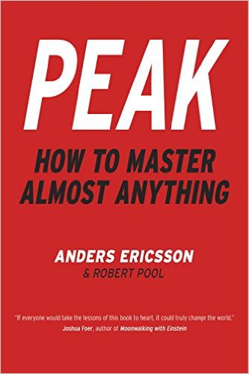
CAVEATS
(2) Case for deliberate practice is based largely on self-reports of practice.

Slide 40

OTHER PIECES OF PUZZLE
1
Ability factors
2
Dispositional factors
3
Genetic factors
4
Task/Situational Factors

Slide 41

ABILITY FACTORS

Slide 42
ABILITY FACTORS
Extraordinary talent
High talent
Performance
Average talent
Low talent
Practice

Slide 43
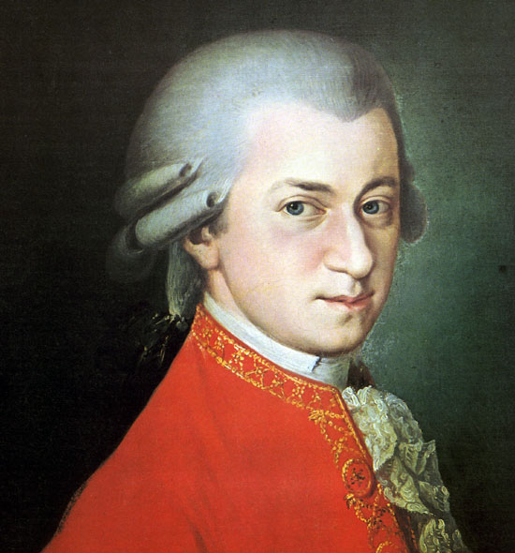
ABILITY FACTORS
Prodigy – a child who performs at a level well above same-age peers.

Slide 44
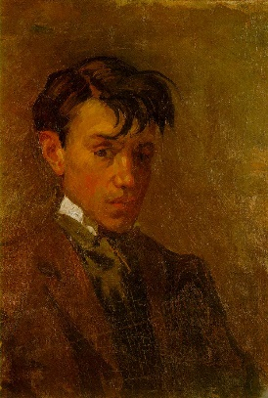
ABILITY FACTORS
Prodigy – a child who performs at a level well above same-age peers.
Self-portrait, Picasso, Age 15

Slide 45
ABILITY FACTORS
Nadia
5 – 6 years
5 years, 6 months

Slide 46
ABILITY FACTORS
6 years

Slide 47
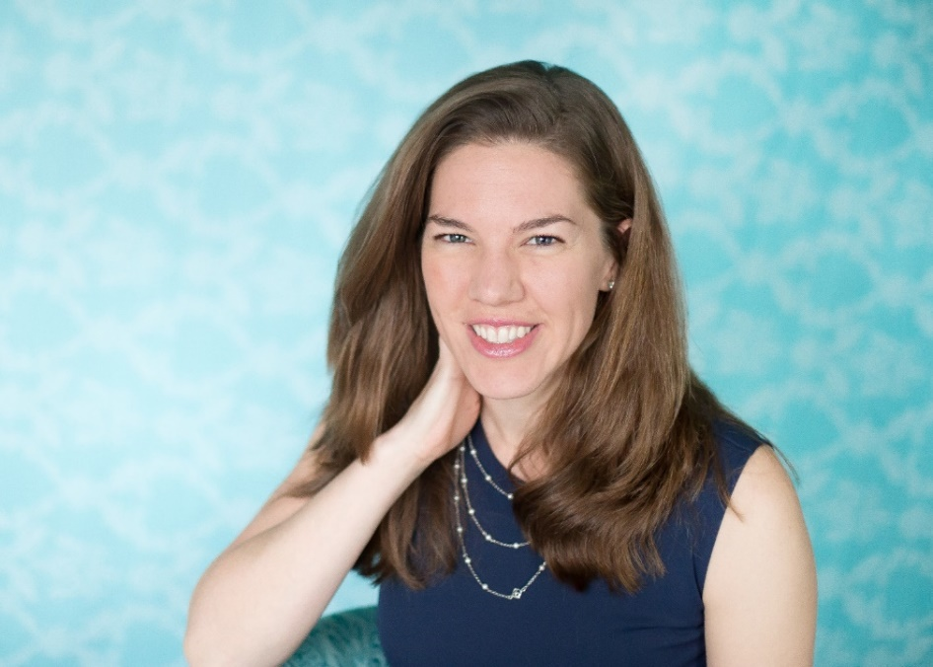
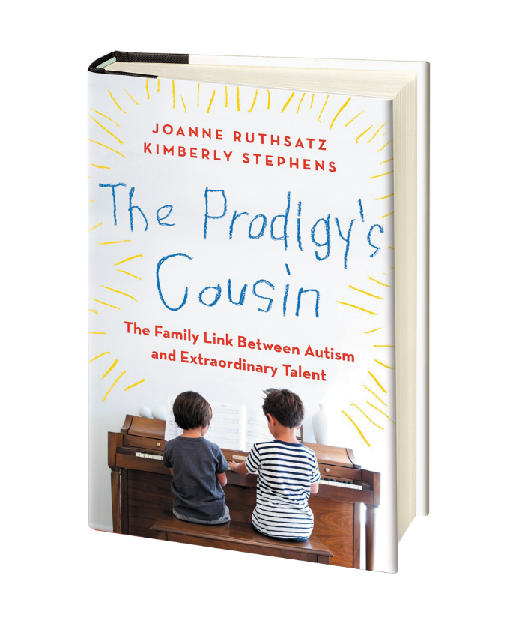
ABILITY FACTORS
Joanne Ruthsatz, The Ohio State U. Mansfield

Slide 48
ABILITY FACTORS
18 prodigies
- 5 music
- 8 art
- 5 math
Joanne Ruthsatz, The Ohio State U. Mansfield

Slide 49
ABILITY FACTORS
Administered Stanford-Binet Intelligence Scales…
Fluid reasoning (FR)
Knowledge (KN)
Quantitative reasoning (QR)
Visual-spatial (VS)
Full-scale IQ (FIQ)
Joanne Ruthsatz, The Ohio State U. Mansfield

Slide 50
ABILITY FACTORS
Prodigy 7: At the time of testing, prodigy seven, a self-taught painter, was nineteen years of age. Although she had been interested in arts and crafts for as long as she could remember, she did not begin to paint until she was 13 years old. She said she was inspired by a young art prodigy she saw on television. After just eighteen months of painting, the prodigy won the National Gold Key award, the most prestigious art award given to high school students, at the age of 15. She was one of 50 recipients of the award across the country. At nineteen, her work is selling for thousands of dollars and is displayed in prestigious art museums around the world. (from Ruthsatz & Urbach, 2012)

Slide 51
ABILITY FACTORS
IQ Score
Stanford-Binet Subtest
Ruthsatz, Ruthsatz-Stephens, & Ruthsatz (2014), Intelligence

Slide 52
ABILITY FACTORS
IQ Score
Stanford-Binet Subtest
Ruthsatz, Ruthsatz-Stephens, & Ruthsatz (2014), Intelligence

Slide 53
ABILITY FACTORS
IQ Score
Stanford-Binet Subtest
Ruthsatz, Ruthsatz-Stephens, & Ruthsatz (2014), Intelligence

Slide 54
ABILITY FACTORS
IQ Score
Stanford-Binet Subtest
Ruthsatz, Ruthsatz-Stephens, & Ruthsatz (2014), Intelligence

Slide 55
ABILITY FACTORS
IQ Score
Stanford-Binet Subtest
Ruthsatz, Ruthsatz-Stephens, & Ruthsatz (2014), Intelligence

Slide 56
ABILITY FACTORS
15 of 18 > 99th percentile
IQ Score
50th to 99.9th percentile
Stanford-Binet Subtest
Ruthsatz, Ruthsatz-Stephens, & Ruthsatz (2014), Intelligence

Slide 57

ABILITY FACTORS
Working memory - ability to focus attention on information critical to performing a task

Slide 58

ABILITY FACTORS
Working memory - ability to focus attention on information critical to performing a task
Randy Engle, Georgia Tech
http://bcove.me/wlpjvmj2

Slide 59
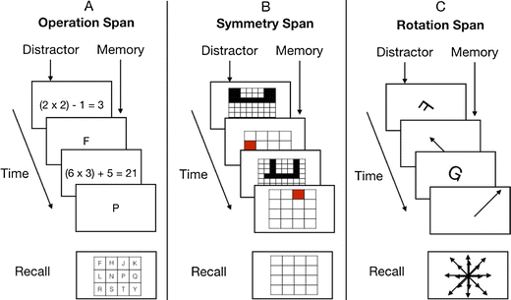
ABILITY FACTORS

Slide 60
ABILITY FACTORS
Name the color, ignore the word…
RED
YELLOW
GREEN
BLUE
PURPLE
ORANGE

Slide 61
ABILITY FACTORS
Name the color, ignore the word…
RED
YELLOW
GREEN
BLUE
PURPLE
ORANGE

Slide 62
ABILITY FACTORS
Incongruent Error Rate
Kane & Engle (2003), J. of Experimental Psychology: General

Slide 63
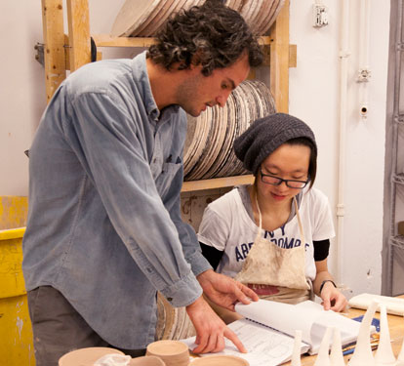
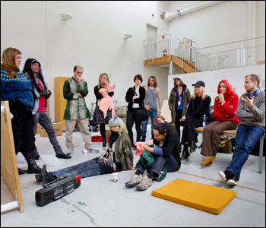
ABILITY FACTORS
Royal Institute of Art, Stockholm
School of Art Institute of Chicago
How might WMC be involved in artistic expertise?

Slide 64
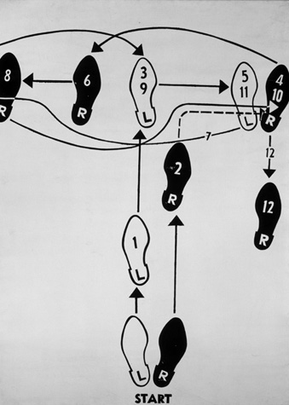
ABILITY FACTORS
How might WMC be involved in artistic expertise?

Slide 65
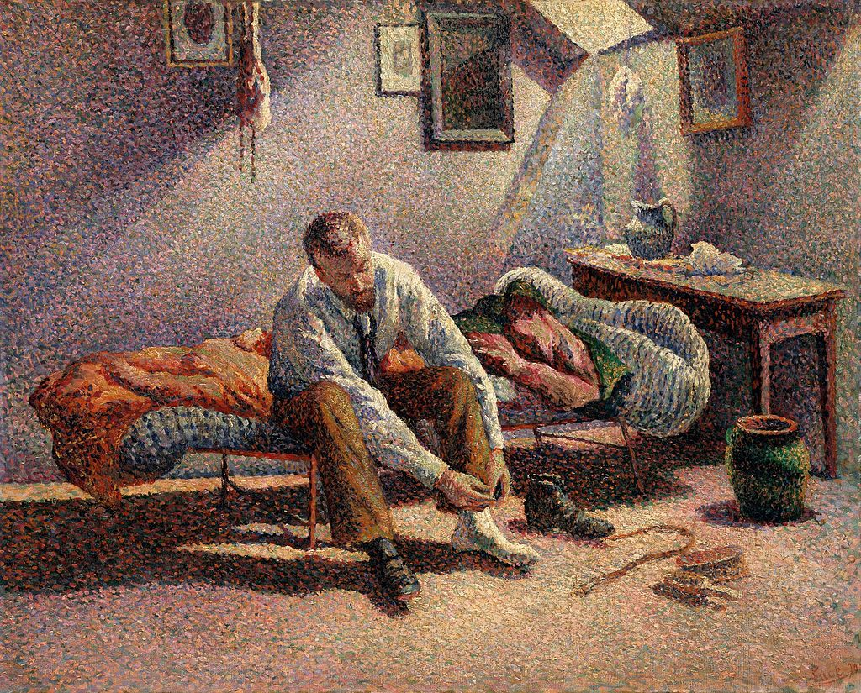
ABILITY FACTORS
Maximilien Luce, Morning, Interior, 1890
How might WMC be involved in artistic expertise?

Slide 66
ABILITY FACTORS
WMC
Performance
Technique
How might WMC be involved in artistic expertise?

Slide 67
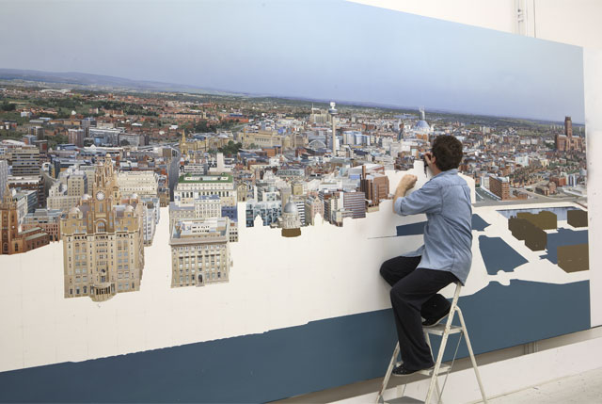
DISPOSITIONAL FACTORS
“Yes, I am obsessed.”
Ben Johnson, on spending 20,000+ hours on cityscape

Slide 68
DISPOSITIONAL FACTORS
Artists vs. Non-Artists: California Psychological Inventory
1.0
Dominance
Capacity for Status
Sociability
Social Presence
Self-Acceptance
Well-being
Responsibility
Socialization
Self-control
Tolerance
Good impression
Communiality
Ach. via Conformity
Ach. via Independence
Intellectual Efficiency
Psych. Mindedness
Flexibility
Femininity
0.5
0
Cohen’s d
-0.5
-1.0
-1.5
-2.0
Sy
Sp
Sa
Wb
Re
So
Sc
Gl
Cm
Ac
Al
Ie
Py
To
Fx
Fe
Feist (1998)
Cs
Do

Slide 69
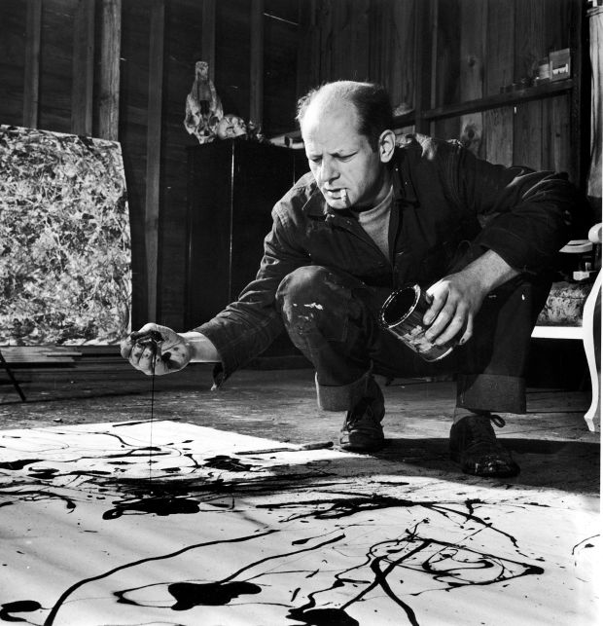
DISPOSITIONAL FACTORS
“[Artists] are conflicted, impulsive, nonconformist, rule-doubting, skeptical, fiercely independent, and not concerned with obligations or duties…although they are conflicted and rebellious, artists seek change, are easily bored, and yet see themselves as talented and worthy people.” (from Feist, 1998)

Slide 70
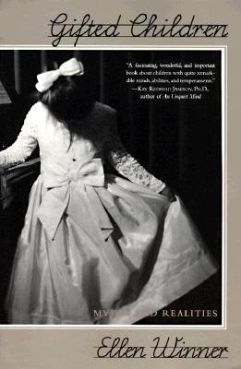
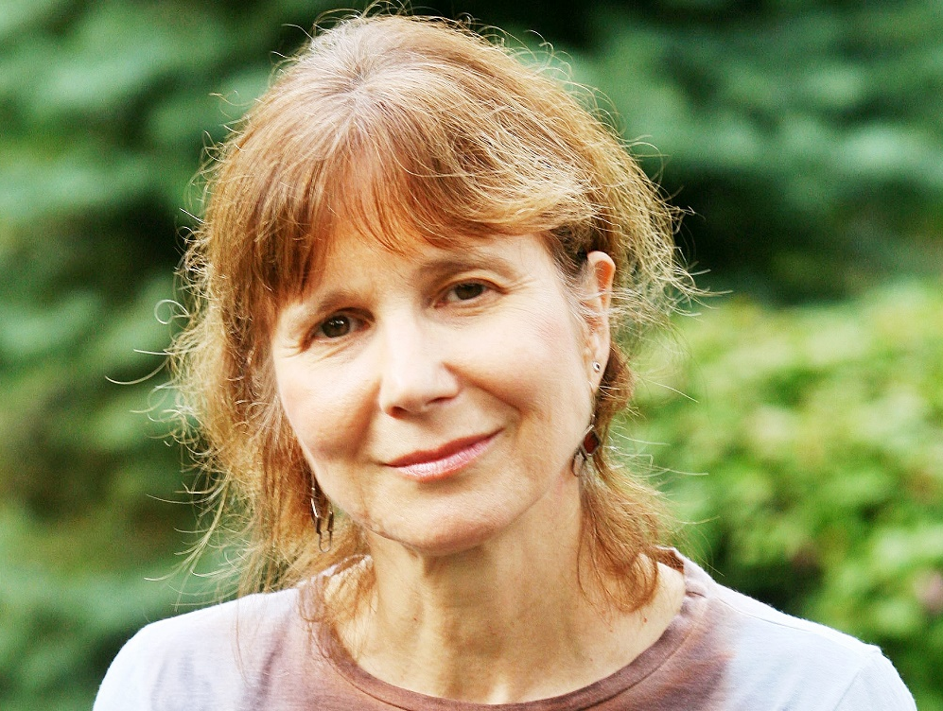
DISPOSITIONAL FACTORS
Ellen Winner, Boston College

Slide 71

DISPOSITIONAL FACTORS
They have a powerful interest in the area, or domain, in which they have high ability —mathematics, say, or art—and they can readily focus so intently on work in this domain that they lose sense of the outside world.”
- Winner (1998)
“

Slide 72

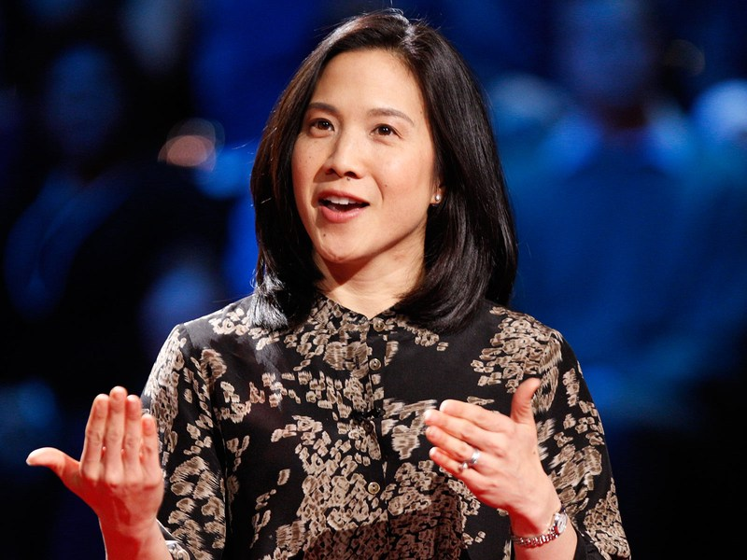
DISPOSITIONAL FACTORS
Angela Duckworth, U. of Pennsylvania

Slide 73
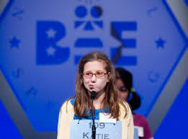
DISPOSITIONAL FACTORS
.31
Deliberate Practice
.38
Spelling Performance
Grit
Duckworth, Kirby, Tsukayama, Berstein, & Ericsson (2011)

Slide 74
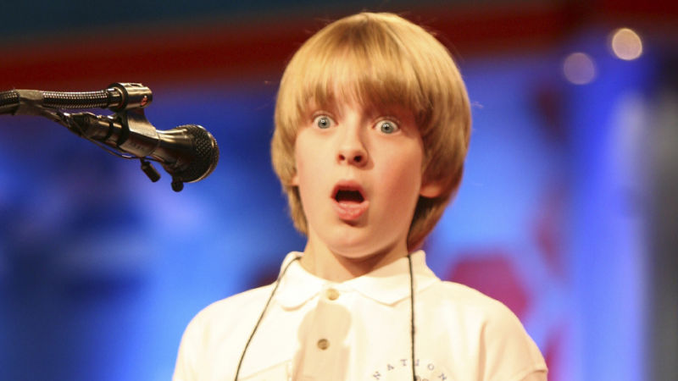
DISPOSITIONAL FACTORS
Other factors could have a direct effect
Emotional Regulation
.31
Deliberate Practice
.38
Spelling Performance
Grit
Duckworth, Kirby, Tsukayama, Berstein, & Ericsson (2011)

Slide 75
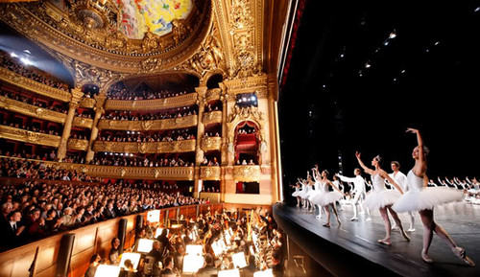
DISPOSITIONAL FACTORS

Slide 76
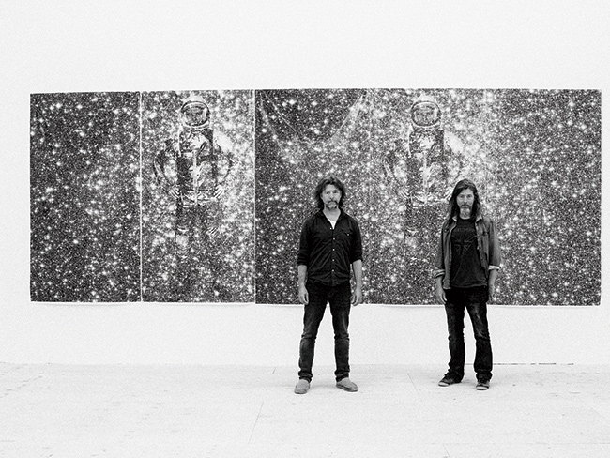
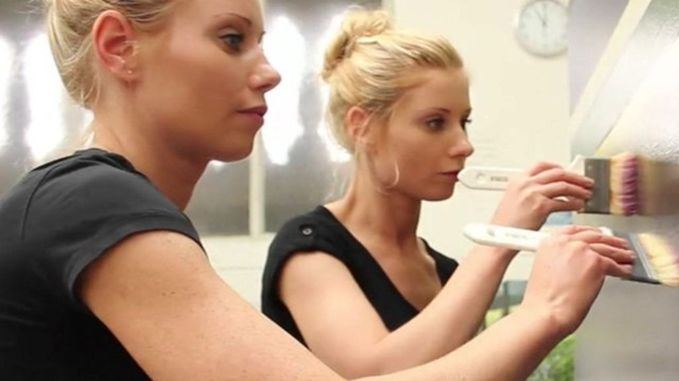
GENETIC FACTORS
Marina and Irina Fabrizius
Mike and Doug Starn

Slide 77
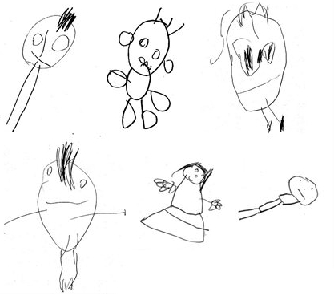
GENETIC FACTORS
Arden et al. (2014) -
7,752 twins complete Draw-A-Person Test and test of general intelligence at age 4, and the latter again at age 10.

Slide 78
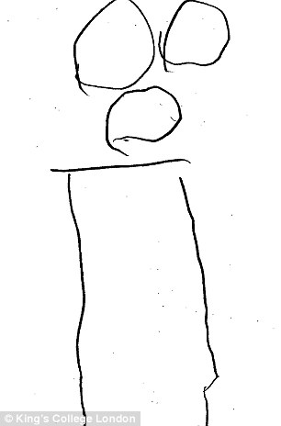
GENETIC FACTORS
Score from 0 – 12, based on presence and correct number of features (e.g., head, eyes, nose, mouth)

Slide 79
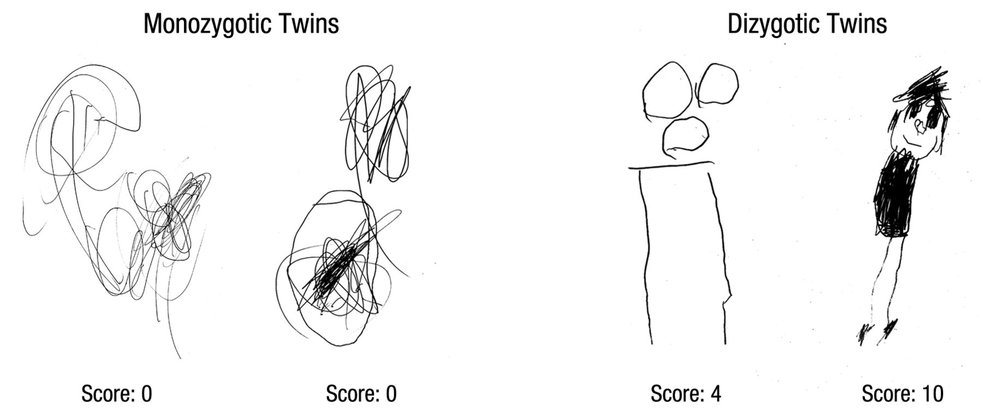
GENETIC FACTORS

Slide 80
GENETIC FACTORS
r = .55
r = .39

Slide 81
GENETIC FACTORS
32%
r = .55
r = .39

Slide 82
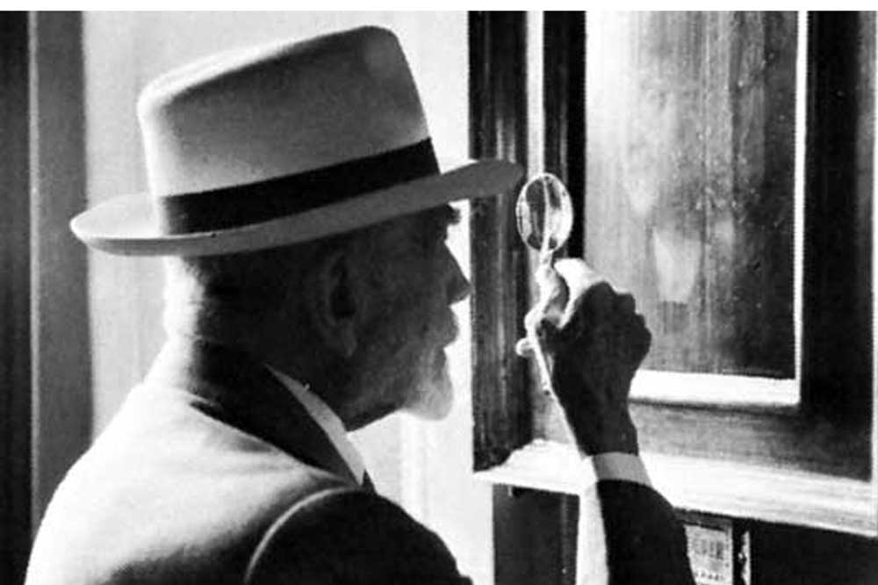
TASK/SITUATIONAL FACTORS
Bernard Berensen, American art critic

Slide 83

TASK/SITUATIONAL FACTORS
Amabile (1979)
Subjects perform simple art task, creating a collage conveying a theme of “silliness”
Half told that work would be evaluated by panel of artists, other half not

Slide 84
TASK/SITUATIONAL FACTORS
Creativity Composite Score
Evaluation Expectation
Amabile (1979), J. of Personality and Social Psychology

Slide 85
TASK/SITUATIONAL FACTORS
Evaluation
Performance
x
WMC

Slide 86
ADVANCING THE SCIENCE OF EXPERTISE

Slide 87
ADVANCING THE SCIENCE OF EXPERTISE
  We need to develop multivariate theories of expertise that take into account as many potentially relevant explanatory constructs as possible.

Slide 88
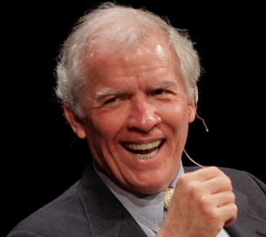
ADVANCING THE SCIENCE OF EXPERTISE
it is extremely likely that environmental factors, including deliberate practice, account for far more variance in performance than does innate capacity in every salient talent domain. Even so, psychology must endeavor to identify all of the significant causal factors behind exceptional performance rather than merely rest content with whatever factor happens to account for the most variance.”
- Simonton (1999)
“
Dean Simonton, UC Davis

Slide 89
Tack så mycket!

Slide 90
ACKNOWLEDGEMENTS
Fredrik Ullén Karolinska Inst.
Miriam Mosing Karolinska Inst.
Brooke Macnamara Case Western Reserve U.
Guillermo Campitelli Edith Cowan U.
Erik Altmann Michigan State U.
Alex Burgoyne Michigan State U.
Fernand Gobet Liverpool U.
Betsy Meinz Southern Illinois U.
Fred Oswald Rice U.
Randy Engle Georgia Tech

Slide 91
Sources for Graphics
http://waterpolo218.deviantart.com/art/no-creativity-346991145
http://article.wn.com/view/2014/11/23/Carlsen_retains_world_chess_title/
http://www.resimbul.com/bisiklet/bisiklet-ne-zaman-ucak-kadar-hizli-gider.xhtml
http://www.patheos.com/blogs/unequallyyoked/category/marriage-2
http://www.stephcurrythrees.com/
http://metropolis.co.jp/arts/agenda/dojoji/
http://www.ozy.com/rising-stars/misty-copeland-ballet-prodigy-turned-activist/30438
http://sanfrancisco.informermg.com/2014/01/05/hollywood-stars-musicians-sports-legends-and-tv-personalities-to-attend-2014-international-ces/
http://fivethirtyeight.com/features/magnus-carlsen-world-chess-championship/?utm_medium=twitter&utm_source=twitterfeed
http://www.beyondtheworld.fr/photos/voulez-vous-danser/
http://commons.wikimedia.org/wiki/File:OdysseyPopeTP1752.jpg
http://commons.wikimedia.org/wiki/File:Galton_at_Bertillon's_(1893).jpg
http://www.mugu.com/galton/books/hereditary-genius/index.html
http://arthistoryproject.com/artists/titian-tiziano-vecellio/
http://quotesgram.com/edward-thorndike-quotes/
http://commons.wikimedia.org/wiki/File:John_Broadus_Watson.JPG
http://www.mocw.cn/?paged=2
http://welltempered.files.wordpress.com/2011/11/violin-lesson.jpg
http://vamtion.deviantart.com/art/hand-123974148
http://commons.wikimedia.org/wiki/File:Svetlana_Zakharova_in_Kitri_Variation_with_the_Bolshoi_Ballet.jpg
http://www.northerntrust.hscni.net/services/1754.htm
http://commons.wikimedia.org/wiki/Wolfgang_Amadeus_Mozart
http://shortstops.info/2014/02/
http://www.dallasnews.com/opinion/latest-columns/20160323-point-person-our-qa-with-kimberly-stephens-on-the-link-between-prodigy-and-autism.ece
http://www.waxmanleavell.com/ebooks/science-%2526-environment
http://www.artandeducation.net/author/royal_academy_of_arts/
https://commons.wikimedia.org/wiki/File:Morning%2C_Interior_-_Luce.jpeg
http://upload.wikimedia.org/wikipedia/commons/thumb/6/60/Morning%2C_Interior_-_Luce.jpeg/744px-Morning%2C_Interior_-_Luce.jpeg
http://www.artsblog.it/post/1560/1560
http://www.gettyimages.com/detail/news-photo/painter-jackson-pollock-cigarette-in-mouth-dropping-paint-news-photo/50406608
http://miter.mit.edu/ellen-winner-on-why-we-need-the-arts/
http://www.amazon.com/Gifted-Children-Realities-Ellen-Winner/dp/0465017606
http://www.ted.com/talks/angela_lee_duckworth_the_key_to_success_grit
https://www.books-express.ro/categorie/sanatate
http://humor.gunaxin.com/category/images-humor/
http://www.dorothee-gilbert.com/2010_08_01_archive.html
http://www.bbc.co.uk/news/magazine-32735289
http://www.movingbeyondthepage.com/images/articles/children-s-drawings-indicate-intelligence.jpg
http://noticias.uol.com.br/ciencia/album/bbc/2014/08/20/desenhos-das-criancas-indicam-futura-inteligencia-diz-estudo.htm
http://www.jonahlehrer.com/
http://www.magnumphotos.com/image/NYC107285.html
http://www.notimeforflashcards.com/category/open-ended-art
(sources listed in order of graphic presentation)

